Slide 1
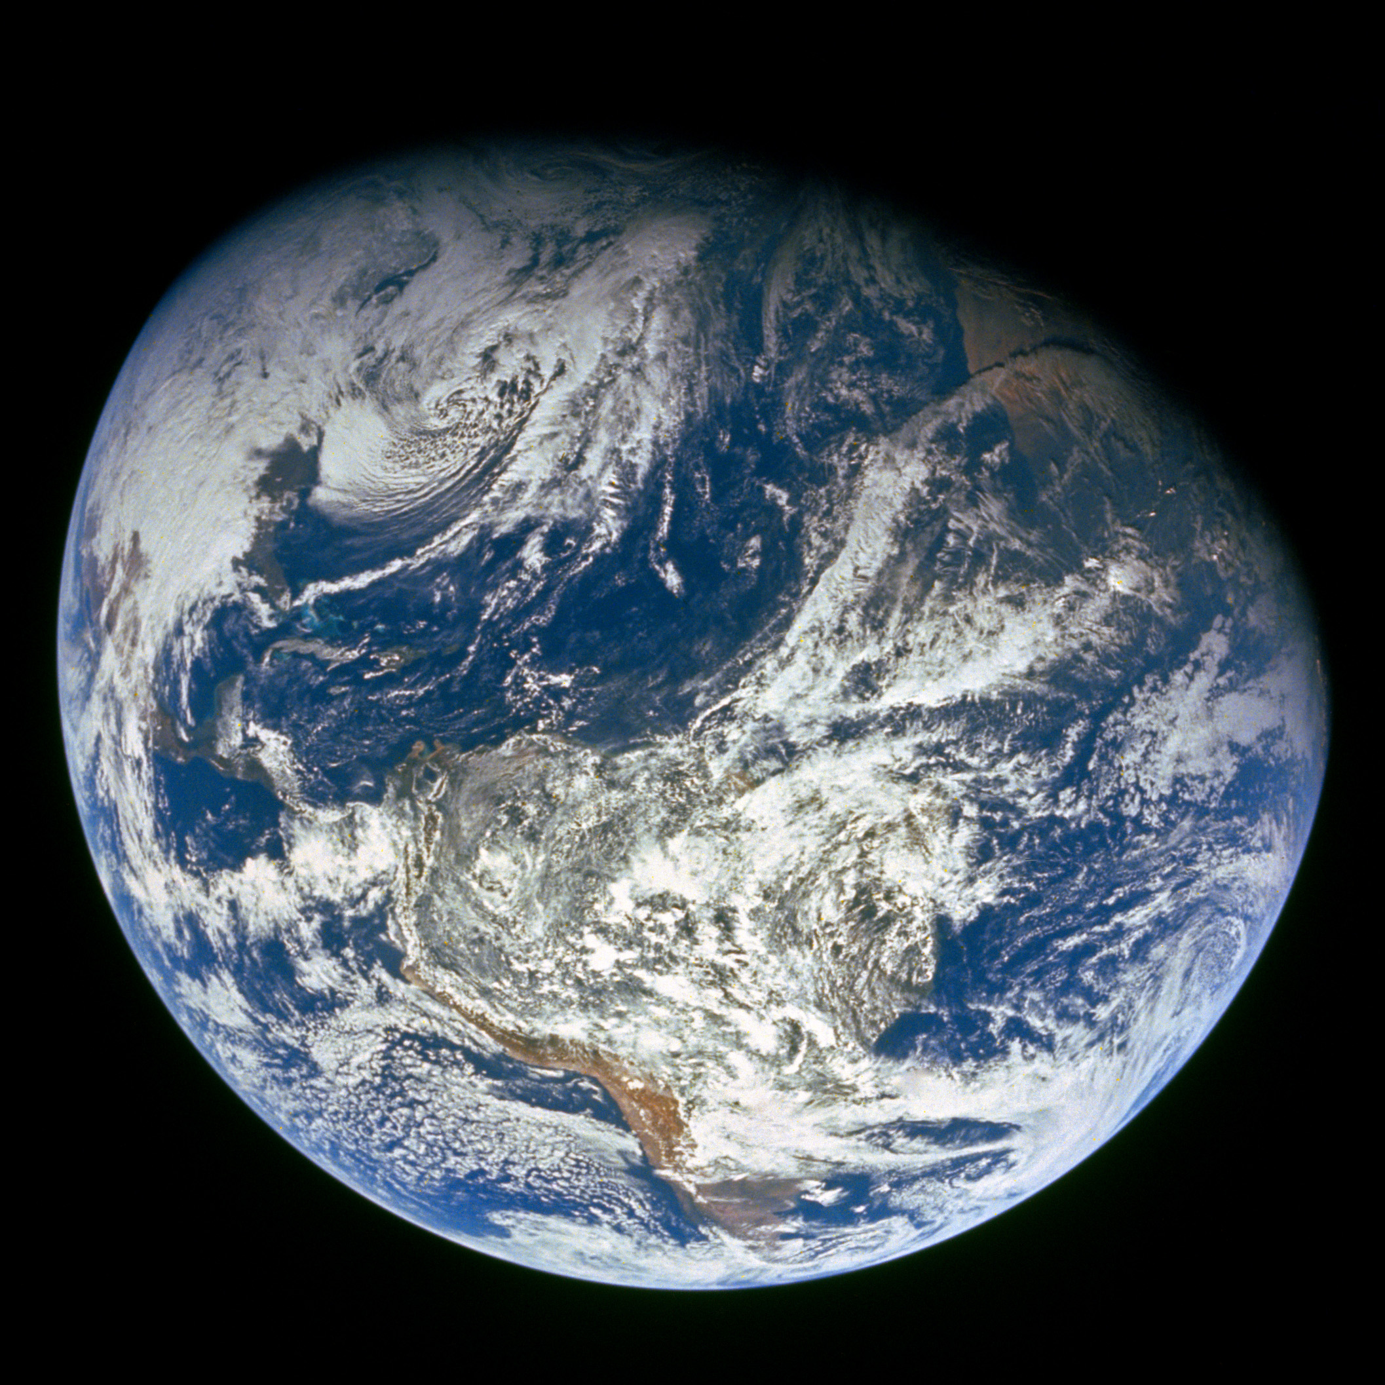
GENESIS
”In the beginning God…”

Slide 2
Review

Slide 3
Four year study of the Bible - 17 Periods
1)
2)
3)
4)
5)
6)
7)
8)
9)
Genesis
10)
11)
12)
13)
14)
15)
16)
17)
Divided Kingdom
Judah Alone
Captivity
Return From Captivity
Years Of Silence
Life Of Christ
The Early Church
The Letters To The Christians
Before The Flood
The Flood
The Scattering Of The People
The Patriarchs
The Exodus
The Wandering In The Wilderness
Invasion & Conquest
Judges
United Kingdom

Slide 4
Creation Days
Day 1 – Light
Day 2 – Firmament
Day 3 – Land, Sea, and Plants
Day 4 – Sun, Moon, and Stars
Day 5 – Sea Creatures and Birds
Day 6 – Land Animals and Mankind
Day 7 – God Rested

Slide 5
“Be Fruitful”
God’s command
  Gen 1:22 To water animals and birds
  Gen 1:28 To Man
  Gen 8:17 To the creatures coming off of Noah’s ark
  Gen 9:1, 7 To Noah and his sons after the flood
Used as a Blessing
  Gen 28:3 Isaac to Jacob
As a Promise to God’s People
  Jer 23:3

Slide 6
The Garden of Eden Gen 2:4-25
God planted a garden eastward…in Eden vv. 8-14
  Every tree pleasing to the sight and good for food was provided
  Tree of Life was there…also Tree of Knowledge of Good and Evil
    God placed man man given a home
    God nourished the garden with water, food man given sustenance
    God commanded man to tend & keep the garden man given work
    God blessed man with Tree of Life man given eternal possibility
    God warned man re: Tree of Knowledge of Good & Evil man given a test

Slide 7
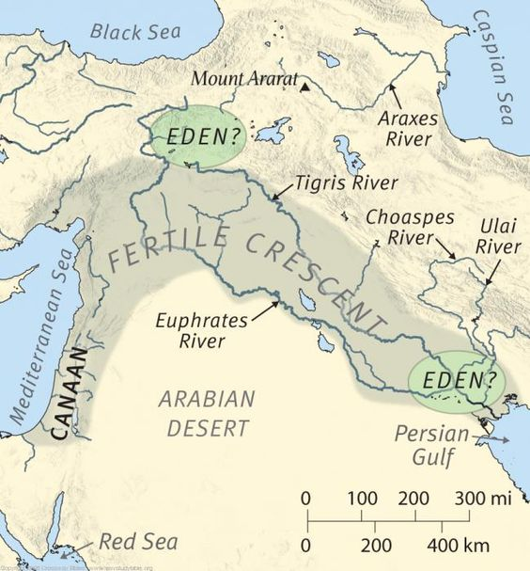
One river flowed out of Eden to water the garden. From there it divided into 4 rivers:
[1] Pishon
[2] Gihon
[3] Tigris
[4] Euphrates

Slide 8
Man was created in the “image of God”
Eph 4:22-24 “to put off your old self, which belongs to your former manner of life and is corrupt through deceitful desires, and to be renewed in the spirit of your minds, and to put on the new self, created after the likeness of God in true righteousness and holiness.”

Slide 9
Cain’s sin and the consequences Genesis 4:1-15
Dealing with sin Genesis 4:6-15
  God did not accept Cain’s offering Genesis 4:5
  Don’t compound sin with sin Genesis 4:5,8
  Acknowledge and correct it Ezekiel 18:21
  Rule over it Genesis 4:7; James 4:7
  May have earthly consequences Genesis 4:11; Romans 1:27
  God is merciful - we may find mercy even for temporal things Genesis 4:15; Joel 2:12-14 (“who knoweth if he will return and repent, and leave a blessing…”); 2 Samuel 12:22 (“who can tell whether God will be gracious to me…”)

Slide 10
Seth’s lineage Genesis 4:25 – 5:32
  Men began to call upon the name of the Lord – the very thing God made man to do. Men began to seek the Lord in an effort to do his will. Acts 17:27; Zephaniah 3:9; Romans 10:13
  Enoch walked with God. He pleased God. Genesis 4:24; Hebrews 11:5
  Why are Abel, Enoch and Noah listed for us in Hebrews 11? As examples to follow.
  Noah was 500 and begat Shem, Ham, and Japheth

Slide 11
Today’s Lesson - Genesis 6 - 9

Slide 12
Context
Who?
  God
  Noah, his wife
  Shem, Ham, Japheth, and their wives
When?
  After Creation
  “The Flood” – 17 Periods
  Noah is at least 500 years old
  Approx Year 1556
Where?
  The Whole Earth

Slide 13
The Years – Gen 5
Parent | When Child Born
Adam | 130
Shem | 105
Enosh | 90
Cainan | 70
Mahalalel | 65
Jared | 162
Enoch | 65
Methuselah | 65
Lamech | 65
Noah | (500)

Slide 14
Man’s State Gen 6
“the wickedness of man was great in the earth”
“every intent of the thoughts of his heart was only evil continually”
“all flesh had corrupted their way on the earth”
“the earth was filled with violence”
Sons of God took wives of the daughters of men
  Angels neither marry nor are given in marriage Matt 22:30
  “For as in the days before the flood, they were eating and drinking, marrying and giving in marriage, until the day that Noah entered the ark” Matt 24:38

Slide 15
Man’s State Gen 6
Apparently there were only 8 righteous people on earth!
  There weren’t 10 righteous people in Sodom Gen 18:16-33
  “Yet I have reserved seven thousand in Israel, all whose knees have not bowed to Baal, and every mouth that has not kissed him.” I Kings 19:18

Slide 16
God Decides To Destroy Earth Gen 6
“the Lord was sorry that He had made man on the earth”
“He was grieved in His heart”
“But Noah found grace in the eyes of the Lord”
“And God said to Noah, “The end of all flesh has come before Me, for the earth is filled with violence through them; and behold, I will destroy them with the earth”

Slide 17
What Kind Of Man Was Noah?
“By faith Noah, being divinely warned of things not yet seen, moved with godly fear, prepared an ark for the saving of his household, by which he condemned the world and became heir of the righteousness which is according to faith” Heb 11:7
“and did not spare the ancient world, but saved Noah, one of eight people, a preacher of righteousness, bringing in the flood on the world of the ungodly” 2 Pet 2:5

Slide 18
What Kind Of Man Was Noah?
Righteous like Daniel and Job Ezek 14:13,14,19,20
Thus Noah did; according to all that God commanded him, so he did. Gen 6:22
And Noah did according to all that the Lord commanded him. Gen 7:5
Then Noah built an altar to the Lord, and took of every clean animal and of every clean bird, and offered burnt offerings on the altar. Gen 8:20
And Noah began to be a farmer, and he planted a vineyard. Then he drank of the wine and was drunk, and became uncovered in his tent. Gen 9:20-21

Slide 19
God’s Instructions for the Ark Gen 6
Gopherwood
Rooms
Cover inside and out with pitch
Length = 300 cubits (~450 ft)
Width = 50 cubits (~75 ft)
Height = 30 cubits (~45 ft)
1 Window
1 Door

Slide 20
God’s Instructions for the Ark Gen 6
Lower, Second and Third decks
Over 100,000 square ft of floor space
Noah, his wife, his sons, their wives to enter ark
Of every bird, animal, and creeping thing, bring in by 2s (male and female)
Food for Noah’s family and the animals
“Thus Noah did; according to all that God commanded him, so he did”

Slide 21
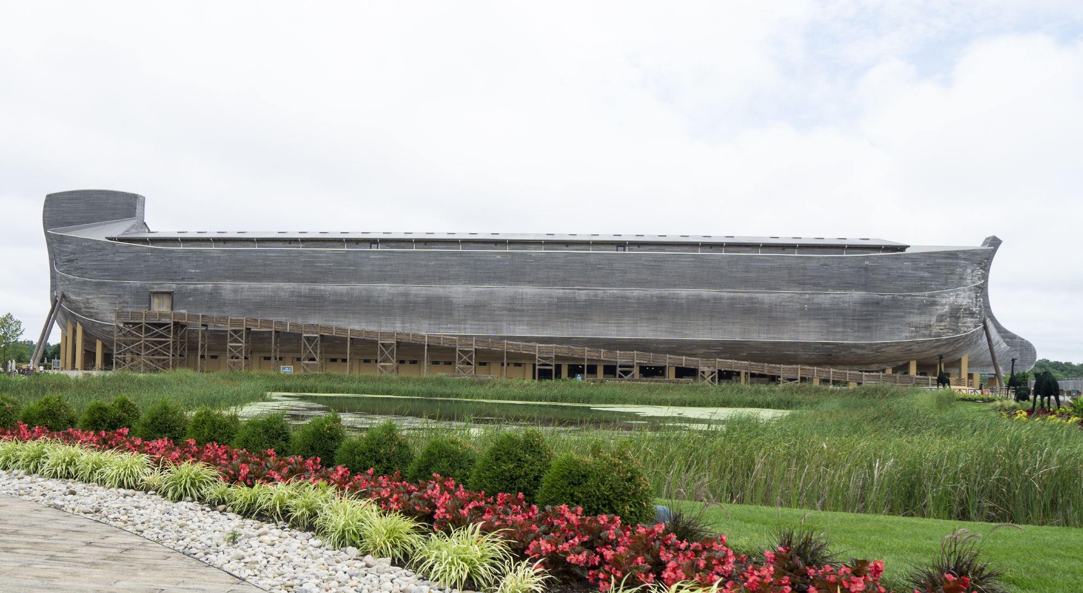

Slide 22
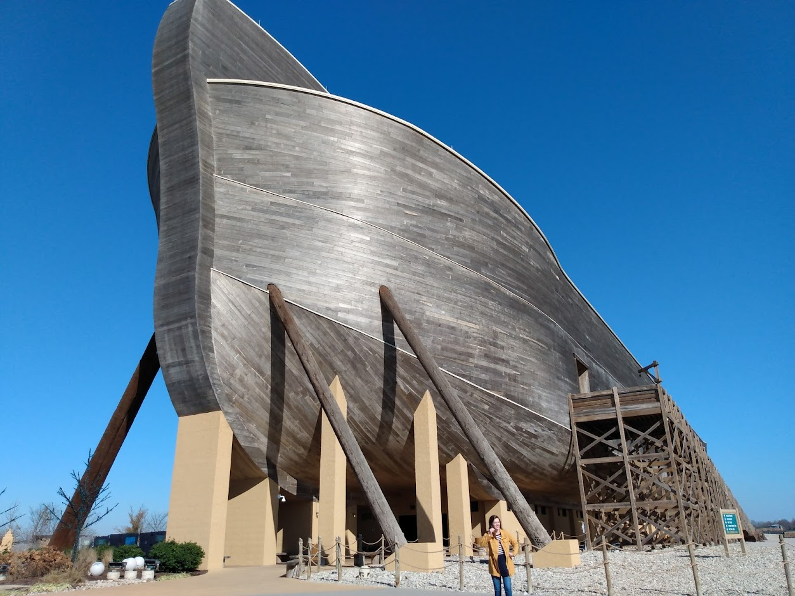

Slide 23
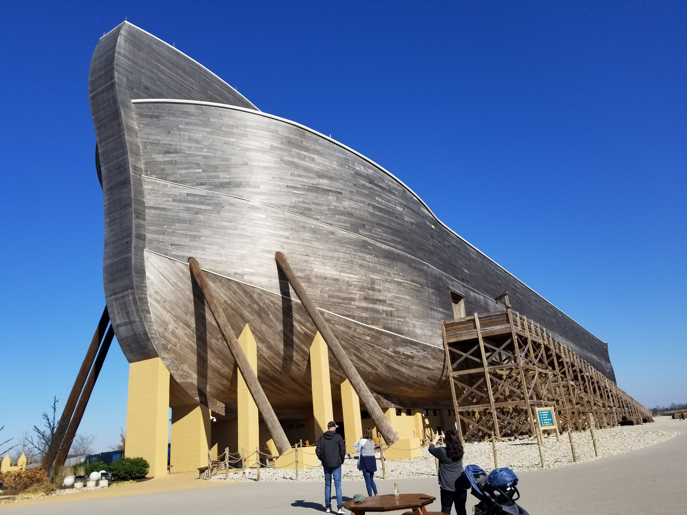

Slide 24
The Flood Gen 7
“Then the Lord said to Noah, “Come into the ark, you and all your household, because I have seen that you are righteous before Me in this generation”
7 of every clean animal (male and female)
2 of every unclean animal (male and female)
7 days till the flood!

Slide 25
The Flood Gen 7
“And Noah did according to all that the Lord commanded him”
Noah, his family, and the animals entered the ark
“In the six hundredth year of Noah’s life, in the second month, the seventeenth day of the month, on that day”
  All the fountains of the great deep were broken up
  Windows of heaven were opened
  Rain was on the earth 40 days and 40 nights

Slide 26
The Flood Gen 7
“The waters prevailed fifteen cubits upward, and the mountains were covered”
15 cubits ~ 22.5 ft

Slide 27
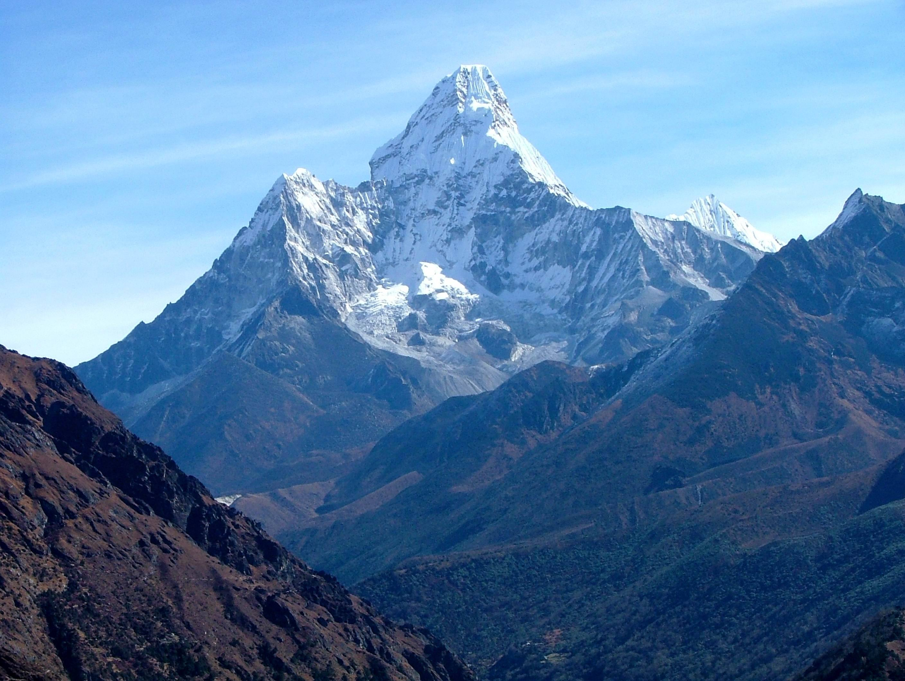
Mount Everest
Highest point on Earth
29,032 feet high
Flood waters = 29,055 feet (Gen. 7:19-20)

Slide 28
The Flood Gen 7
“all flesh died that moved on the earth”
  Birds, cattle, beasts, and every creeping thing
  Man
  “All in whose nostrils was the breath of the spirit of life”
  “all living things which were on the face of the ground”
  “Only Noah and those who were with him in the ark remained alive”

Slide 29
The Exodus From The Ark Gen 8
God caused:
  Wind to pass over the earth
  Waters subside
  Fountains of the deep stopped
  Windows of heaven stopped
  Rain was restrained
Ark rested in the seventh month, 17th day of the month on the “mountains of Ararat”
On the 10th month, 1st day of the month, “the tops of the mountains were seen”

Slide 30
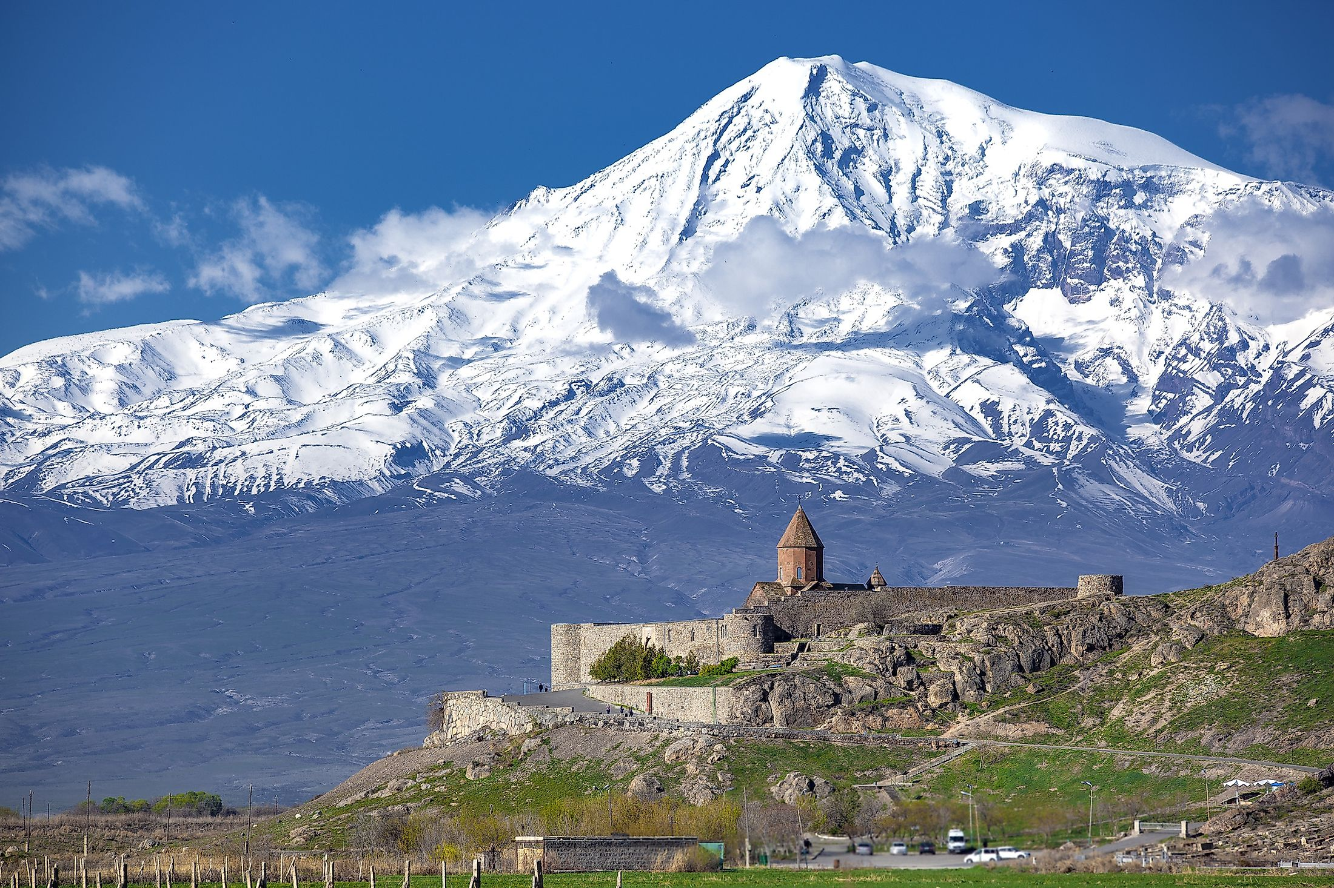
Notes:
Mt Ararat

Slide 31
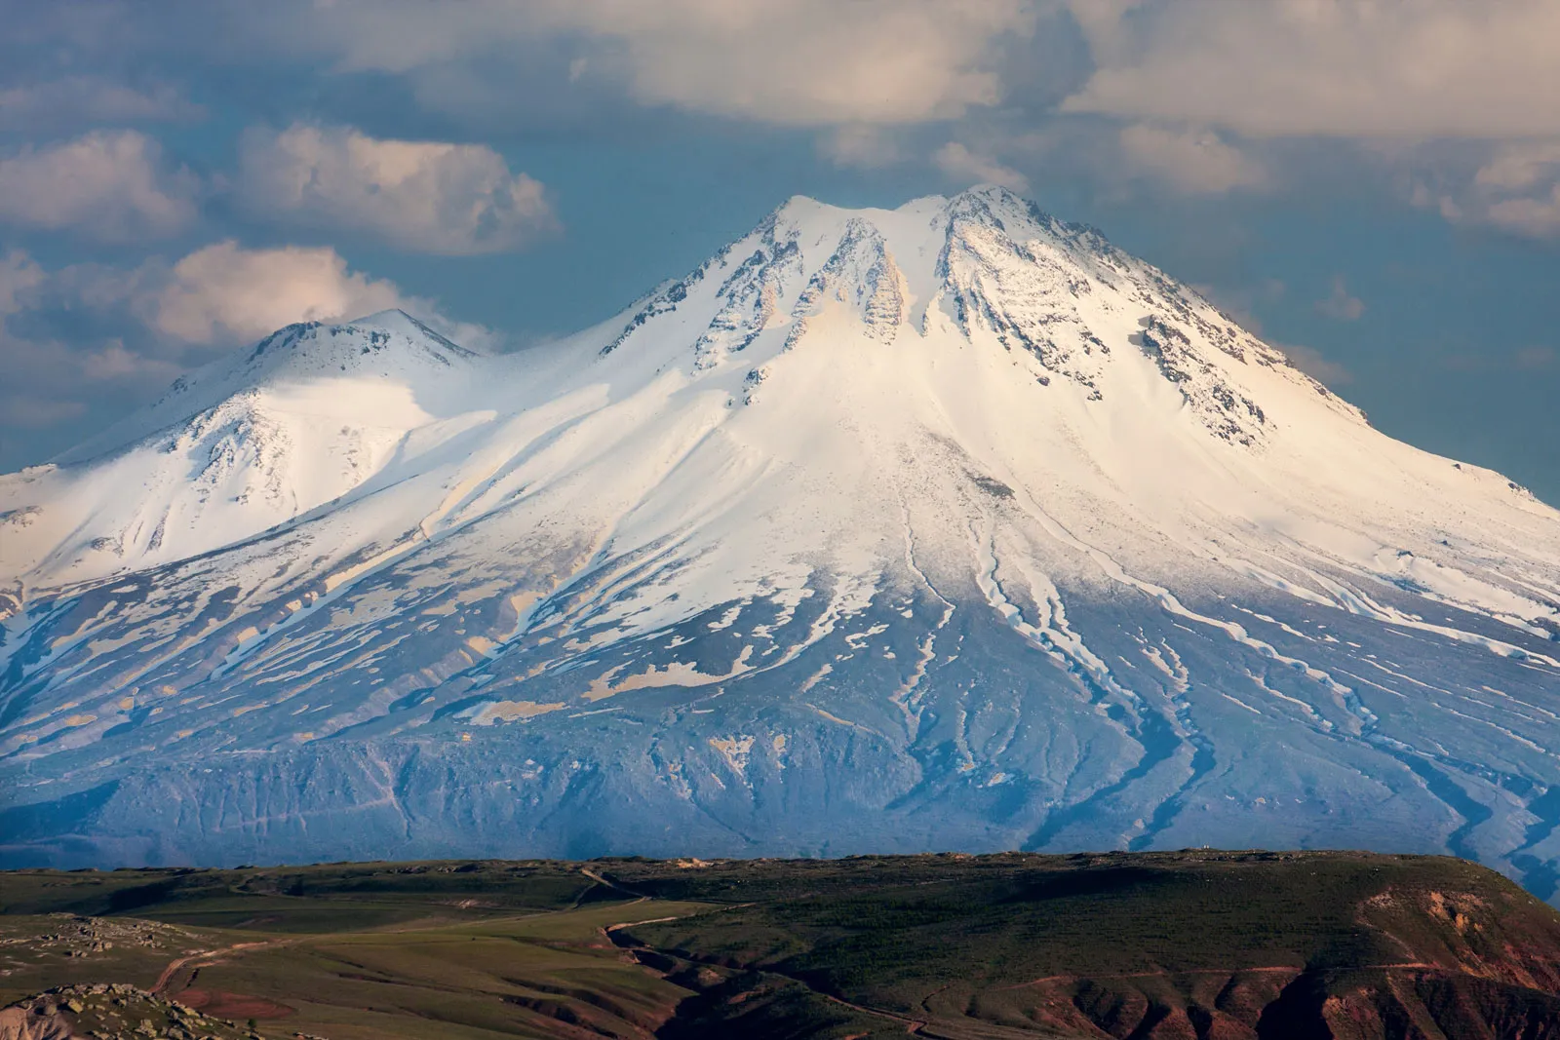
Notes:
Ararat consists of two peaks, their summits about 7 miles (11 km) apart. Great Ararat, or Büyük Ağrı Dağı, which reaches an elevation of 16,945 feet (5,165 metres) above sea level, is the highest peak in Turkey. Little Ararat, or Küçük Ağrı Dağı, rises in a smooth, steep, nearly perfect cone to 12,782 feet (3,896 metres).
https://www.britannica.com/place/Mount-Ararat

Slide 32
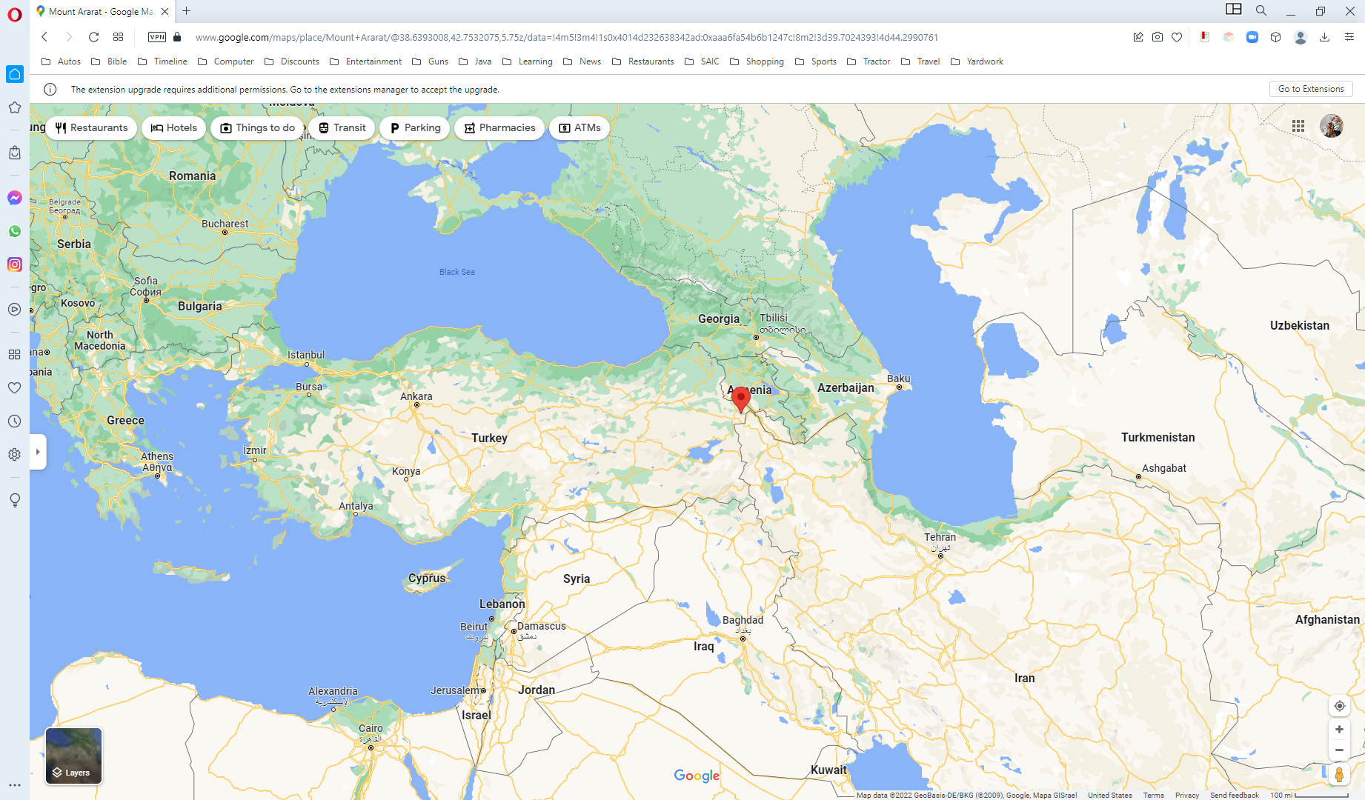
Notes:
Ararat consists of two peaks, their summits about 7 miles (11 km) apart. Great Ararat, or Büyük Ağrı Dağı, which reaches an elevation of 16,945 feet (5,165 metres) above sea level, is the highest peak in Turkey. Little Ararat, or Küçük Ağrı Dağı, rises in a smooth, steep, nearly perfect cone to 12,782 feet (3,896 metres).
https://www.britannica.com/place/Mount-Ararat

Slide 33
The Exodus From The Ark Gen 8
  NKJV Gen 11:1-2 Now the whole earth had one language and one speech. And it came to pass, as they journeyed from the east, that they found a plain in the land of Shinar, and they dwelt there.
  NIV Gen 11:1-2 Now the whole world had one language and a common speech. As people moved eastward, they found a plain in Shinar[ and settled there.

Slide 34
The Exodus From The Ark Gen 8
Noah tested the waters by:
  Sending out a raven
    It never came back
  Sending out a dove
  Sending out the dove a second time
    Returned with an olive leaf in its mouth
  Sending the dove out a 3rd time
    It didn’t return
  In Noah’s 601st year, 1st month, 1st day of the month, the waters were dried up from the earth
    Noah removed the covering of the ark and looked

Slide 35
The Exodus From The Ark Gen 8
In Noah’s 601st year, 2nd month, 27th day of the month:
  The earth was dry
  God told Noah for him and his family and the animals to leave the ark

Slide 36
The Exodus From The Ark Gen 8
Noah built an altar and made an offering:
  Of every clean animal
  Of every clean bird
“And the Lord smelled a soothing aroma”

Slide 37
The Exodus From The Ark Gen 8
The Lord said in His heart:
  I will never again curse the ground for man’s sake (even though his heart is evil)
  I will never again destroy every living thing as I have done
  While earth remains these will not cease:
    Seedtime
    Harvest
    Cold
    Heat
    Winter
    Summer
    Day
    Night

Slide 38
The Exodus From The Ark Gen 8
To Adam - Cursed is the ground for your sake Gen 3:17
To Cain - When you till the ground, it shall no longer yield its strength to you. Gen 4:12
Lamech said - And he called his name Noah, saying, “This one will comfort us concerning our work and the toil of our hands, because of the ground which the Lord has cursed.” Gen 5:29

Slide 39
Time Line For Noah In The Ark
Noah, his family & all the animals entered the ark 7:10-13 (600th year, 2nd month, 17th day)
Solid rain & flooding for 40 days & night 7:12
Water prevailed for 150 days after the rain/floods stopped 7:24
Waters began decreasing at the end of the 150 days 8:3
Ark rested on Ararat 8:4 (600th year, 7th month, 17th day)
Mountain tops visible 8:5 (600th year, 10th month, 1st day)
Noah opened the window, releasing a dove & raven 8:6-12 (600th year, 11th month, 11th day)
Noah removed the ark’s covering… the earth was dry 8:13 (601st year, 1st month, 1st day)
Noah, his family, & all the animals came out of the ark 8:14-18 (601st year, 2nd month, 27th day)
Noah in the ark for 1 year, 10 days

Slide 40
Life After The Flood Gen 9
God told Noah and his sons:
  “Be fruitful and multiply, and fill the earth”
  The dread of you shall be on all animals
  Animals are food just like herbs
  Don’t eat blood
  “Whoever sheds man’s blood, By man his blood shall be shed”
  He made a covenant to never destroy the earth by flood again
  The rainbow is a sign of that covenant

Slide 41
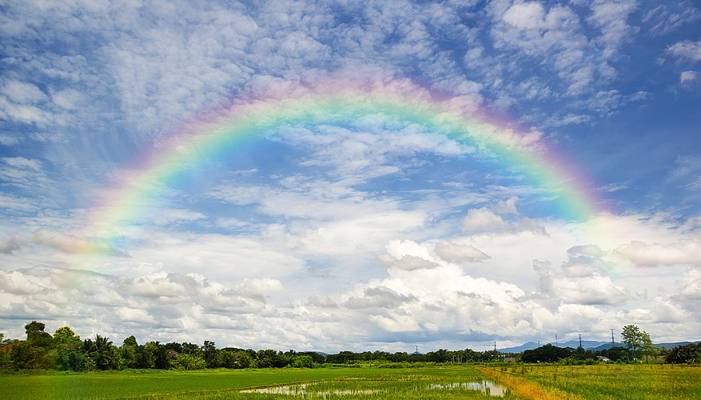

Slide 42
Life After The Flood Gen 9
The whole earth was populated by Shem, Ham, and Japheth

Slide 43
Life After The Flood Gen 9
Noah became a farmer – planted a vineyard
Noah got drunk from the wine of that vineyard
Noah became uncovered in his tent
Ham saw his father’s nakedness
Ham told his brothers
His brothers covered their father without looking at him
Noah cursed Canaan, Ham’s son because of this
Noah blessed Shem and Japheth

Slide 44
Summary and Application
Sin Makes God Unhappy
  “the Lord was sorry he made man”
  “He was grieved in His heart”
  “I will destroy them with the earth”
  Of how much worse punishment, do you suppose, will he be thought worthy who has trampled the Son of God underfoot, counted the blood of the covenant by which he was sanctified a common thing, and insulted the Spirit of grace? Heb 10:29

Slide 45
Summary and Application
Noah Was Obedient
  As God commanded, so Noah did
Noah and his family stood alone
  They were the only ones saved
But Even Noah Sinned
  He Got drunk from his own wine

Slide 46
Summary and Application
Baptism is an antitype of the flood
  when once the Divine longsuffering waited in the days of Noah, while the ark was being prepared, in which a few, that is, eight souls, were saved through water. ²¹ There is also an antitype which now saves us—baptism (not the removal of the filth of the flesh, but the answer of a good conscience toward God), through the resurrection of Jesus Christ I Pet 3:20-21

Slide 47
Summary and Application
Antitype Definition
  One that is foreshadowed by or identified with an earlier symbol or type, such as a figure in the New Testament who has a counterpart in the Old Testament.

Slide 48
Summary and Application
The Earth will be destroyed, just not with a flood
  But the day of the Lord will come as a thief in the night, in which the heavens will pass away with a great noise, and the elements will melt with fervent heat; both the earth and the works that are in it will be burned up. II Pet 3:10

Slide 49
Follow-Up

Slide 50
Firsts / Beginnings
Flood
Boat/Ark
Rainbow
The Word “righteous”
Gopher Wood
Rain?
Clean and Unclean Animals
Altar (did Abel use an altar?)

